Slide 1

Learn SQL from Scratch
Bowen Tan
July 13th, 2018

Slide 2
Table of Contents
1. Get familiar with the company.
1.1. How many campaigns and sources does CoolTShirts use and how are they related? Be sure to explain the difference between utm_campaign and utm_source.
1.2. What pages are on their website?
2. What is the user journey?
2.1. How many first touches is each campaign responsible for?
2.2. How many last touches is each campaign responsible for?
2.3. How many visitors make a purchase?
2.4. How many last touches on the purchase page is each campaign responsible for?
2.5. What is the typical user journey?
3. Optimize the campaign budget
3.1. CoolTShirts can re-invest in 5 campaigns. Which should they pick and why?

Slide 3
1. Get Familiar With The Company

Slide 4
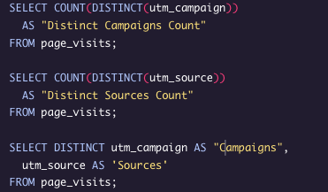
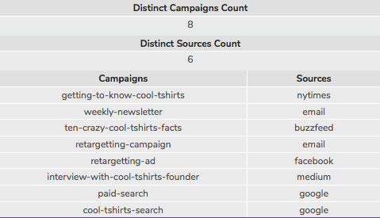
1.1 How many campaigns and sources does CoolTShirts use and how are they related?
CoolTShirts has 8 distinct campaigns and 6 distinct sources.
Campaigns are specific messages that are designed to grab the interests of potential customers
Sources are places where the campaigns are sent or displayed allowing for the potential customers to click the specific campaign messages

Slide 5
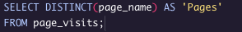
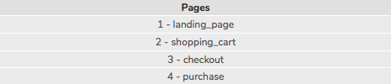
1.2 What pages are on their website?
There are currently 4 different types of pages on the website. First the “landing_page”, second the “shopping_cart”, third the “checkout” page, and lastly is the “purchase” page
These pages guide the customer to purchase the products

Slide 6
2. What Is The User Journey?

Slide 7
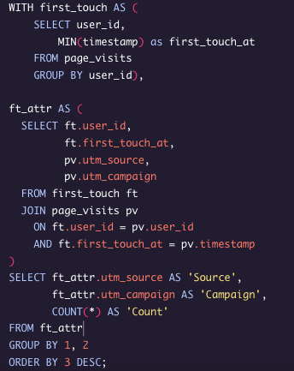
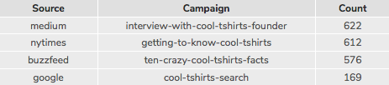
2.1 How many first touches is each campaign responsible for?
Using the MIN date we found 4 first touch campaigns.
Interesting to note that a lot of the first touches are from users who were interested in knowing more about the founder of CoolTShirts and more about CoolTShirts in general.
The last first touch is from users actually searching for CoolTShirts instead of from article sites

Slide 8
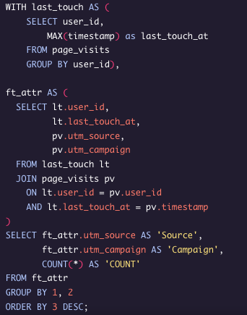
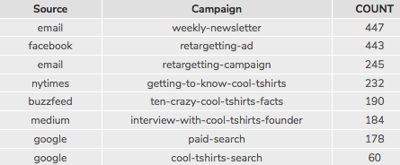
2.2 How many last touches is each campaign responsible for?
Using the MAX date we found 8 last touch campaigns
We can tell that the last touches are significantly different from the first touches. We can assume that the last touch campaigns that are higher up the list were more for users that already knew about CoolTshirts and were retargeted so they would purchase a product

Slide 9
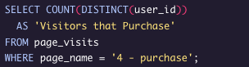
2.3 How many visitors make a purchase?
From looking at the first touches on question 2.1, there were 1979 first touches to the site and we can see 361 users actually purchased a product so the conversion rate is (361 / 1979) 18.2%

Slide 10
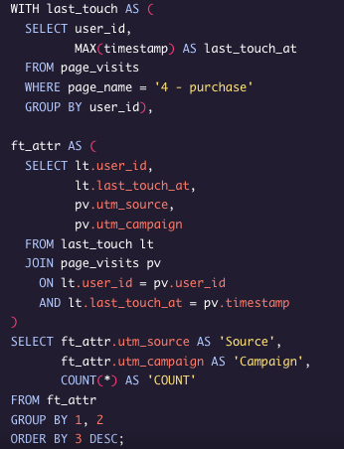
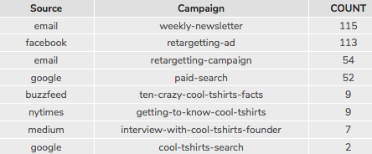
2.4 How many last touches on the purchase page is each campaign responsible for?
Using the Max date along with the purchase page the weekly newsletter and retargeting ads were crucial in converting purchases
There is a significant difference from what draws in the customers versus converting them to paid customers

Slide 11
2.5 What is the typical user journey?
The typical user journey first starts with getting to know CoolTShirts. From our First Touch campaigns, we can we tell that potential customers are drawn in by article campaigns (“Interview with CoolTShirts Founder”, “Getting to know CoolTShirts”, and “Ten crazy CoolTShirts fact”) to know more about the product and how it started. 91% (622 + 612 + 576 / 1979) of the total first touches are articles and only 9% (169 / 1979) were from individual searches
From the Last Touches we can then tell that that the original First Touch campaigns were not as effective, they only accounted for 31% (232 + 190 + 184 / 1979) of last touches. The retargeting ads were actually more effective in getting the potential customers back which accounted for 57%(447 +443 + 245 / 1979) of the Last Touches which means that users normally need a reminder to come back to the site
First Touch
Last Touch

Slide 12
2.5 What is the typical user journey? (Continued)
Lastly we would look at the actual customers who purchased. So what we see so far is that potential customers are drawn in by article campaigns and then they would typically have to be reminded to come back through retargeting ads. Now we can see that once the users are retargeted there is more of a likely chance of them purchasing a product. 78% (115 + 113 + 54 / 361) of the total purchases are from retargeting ads versus only 7% (9 + 9 + 7 / 361) who were from the article campaigns.
Last Touch - Purchased

Slide 13
3. Optimize The Campaign Budget

Slide 14
3.1. CoolTShirts can re-invest in 5 campaigns. Which should they pick and why?
Looking at the trend of the typical user journey we know that most users will need a reminder or retargeting ads in order for them to purchase the product.
Personally if I were to re-invest in 5 campaigns I would first choose the 3 article campaigns, and then the two top retargeting ads (weekly newsletter and retargeting-ad)
With the combination it shows that most users who end up purchasing want to know about the product first but then they would be more likely to purchase once they get a reminder through email or from a Facebook ad.
Last Touch - Purchased

